Slide 1
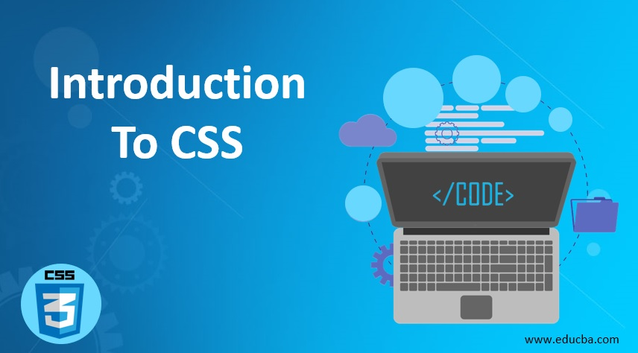

Slide 2

What is CSS
CSS (Cascading Style Sheets) is a language used to style and design the look of a webpage. It controls things like colors, fonts, layout, and spacing, making a webpage look good and organized.
Haykon Wium Lie proposed the idea of CSS 1994- .
The first version of CSS 1 was invented 1996.
CSS 2 was released and work on CSS 3 began1998.
CSS 3 was released in the year 2011 .
HÃ¥kon Wium Lie

Slide 3
What is CSS
CSS stands for Cascading style sheet.
Stylesheet means a sheet for providing styling.
Cascading means one on top of other. We can design one element only with different ways and all those styling will be applied on that element.
All that styling will be applied in the form of layers one after other, and if we provide same property through different ways, all will be applied and the one with the highest priority will be visible to the user.
This is what we mean by cascading stylesheet.

Slide 4
CSS Rule :
Selector {
propertyName1 :value;
propertyName1 :value;
.
.
.
propertyName1 :value;
}
Each property consist of key & value pair seprated by colon .
Each property is seprated by Semicolon .

Slide 5
Ways to apply css
We can achieve css in 3 ways .
They are:
1. Inline CSS
2. Internal CSS
3. External CSS
1. Inline CSS :
It is a way of applying the CSS in the same line. By using style attribute .
<h1 style="color: white ; background-color: blue;">Let’s dive into css </h1>

Slide 6
Types of CSS
<html>
<head>
<title>Document</title>
<style>
h1 {
color: white;
background-color: blue;
}
</style>
</head>
<body>
<h1>Let's dive into CSS</h1>
</body>
</html>
2. Internal CSS:
It is a way of adding the CSS in the same html file itself. By using Style Tag. We can use style tag anywhere in the html file.
It’s recommended to use in a head tag.

Slide 7
Types of CSS
<!-- index.html -->
<html>
<head>
<title>Document</title>
<link rel="stylesheet" href="./style.css">
</head>
<body>
<h1>Let's dive into CSS</h1>
</body>
</html>
3. External CSS:
It is a way of writing all the css code in one file which is saved with . css extension. That css file we have to link to the html file by using the link tag.
Note:
1. The first will always be taken by inline CSS. because of the most recent update.
2. Internal vs External depends on code flow which is written at last.
/* style.css */
h1 {
color: white;
background-color: blue;
}

Slide 8
CSS Selectors
To apply the css Properties, we can target the html elements in many ways.
They are:
1. Simple Selector
2. Combinator Selector
3. Pseudo Class Selector

Slide 9
Simple selectors
1. Simple Selectors:
To target the element based on classes / id’s / tagname we have basic selectors.
They are:
1. TagName
2. Grouping
3. Universal
4. Id Name
5. Class Name
● TagName:
○ To target the element based on tagname itself we have to use tagName selector.
○ The symbol was the tagname itself.
● Grouping:
○ To target multiple elements at a time we have to use a grouping selector.
○ Whenever we need to pass similar properties for multiple elements we can use a grouping selector.
○ The symbol used to combine all elements is comma (,)

Slide 10
Simple selector
● Universal:
○ It will target all the elements in the document including body tag too.
○ The symbol used is asterisk (*).
● Id Name:
○ To target the elements uniquely we have to use an id name.
○ In CSS id name can be duplicated also there is no problem,
○ But once we moved to js it will cause problem.
○ Repetition of id name will not work. So it is highly recommended not to use it from now on.
○ The Symbol used is hash (#).
● Class Name:
○ To target the specific elements on the basis of class name we have to use class name.
○ Class attribute allows multiple identifier names in the same attribute.
○ Class names can be repetitive also.
○ The symbol used is dot (.).

Slide 11
Selector specificity
We can provide css to that same element, through multiple ways like inline css, or in external/internal using id, class, tagname or universal. So which one will be visible to the user, if provide css to an element using all the possible ways.
If we provide different properties all will be applied and will be visible, but if we provide same css properties.
The highest preference is given to the inline css, as it applied direct in the element, after that id is given the highest preference as it is used to uniquely identify an element, then we have class which is used to group multiple elements together than we have tagname and at the last we have universal which applies to all.
Inline ← Id ← Class ← Tagname ← Universal

Slide 12
Combinator selector
2. Combinator Selectors:
It is a combination of 2 simple selectors. Based on the relation b/w 2 elements the css will target the elements.
They are:
1.Descendent Selector
2. Direct Child Selector
3. Adjacent Sibling Selector
4. General Sibling Selector
● Descendent Selector :
○ It will target all the children, grandchildren , great grandchildren and so on. ○ The symbol used is space ( ).
● Direct Child Selector :
○ It will target only the children but not grandchildren , great grandchildren and so on. ○ The symbol used is greater than ( > ).

Slide 13
Combinator selector
● Adjacent Sibling Selector :
○ It will target only the first right sibling of the element.
○ The symbol used is plus ( + ).
● General Sibling Selector:
○ It will target all the siblings to the right of the element.
○ The symbol used is tilde ( ~ ).

Slide 14
Pseudo Class Selectors
3. Pseudo Class Selectors
These are the special selectors , the symbol used is single colon (:). A pseudo-class is used to define a special state of an element.
For example, it can be used to:
Style an element when a user moves the mouse over it
Style visited and unvisited links differently
Style an element when it gets focus
Style valid/invalid/required/optional form elements
● :hover → It will apply the properties whenever we move the cursor on the element.
● :link → It will apply the properties whenever the link is not visited.
● :visited → It will apply the properties whenever the link is visited.
● :active → It will apply the properties whenever hyper link is in active state.
● :first-child → It will target only the first child.
● :last-child → It will target only the last child.
● :nth-child (even / odd / 2n / 2n+1 ) → It will target the specific child based on the parameter.

Slide 15
CSS Units
CSS Units :
● In CSS, Units will specify the length of an element / size of content.
● Units were categorized into 2 Ways
● They are:
1. Absolute Units
2. Relative Units
Absolute Units:
These units are static, It will not depend on any other values. Absolute Units are:
1. mm
2. cm
3. in 1in → 16px
4. px

Slide 16
CSS Units
Relative Units:
These units are dynamic, It will depend on some other values. Relative Units are:
1. vw → depends on viewport width
2. vh → depends on viewport height
3. % → depends on parent element
4. rem → depends on root element
5. em → depends on parent element

Slide 17
Text Properties
Text Properties are basically used to apply CSS effects on text content. Text properties are:
1. color
2. text-align
3. text-transform
4. text-decoration
5. text-indent
6. text-wrap
7. letter-spacing
8. word-spacing
9. line-height
10. text-shadow

Slide 18
Text Properties
color: It will change the color of the text.
Syntax:
color : value;
Values = Any Color.
text-align: It is used to align the content based on the value.
Syntax:
text-align : value;
Values = left / start , center , right / end , justify
text-transform: It will convert the text into other formats.
Syntax:
text-transform : value;
Values = lowercase , uppercase , capitalize.

Slide 19
Text Properties
text-decoration: It will decorate the text by providing underline or overline with special styles.
It is a shorthand property of text-decoration-line , text-decoration-style & text-decoration-color.
Syntax:
text-decoration: text-decoration-line text-decoration-style text-decoration-color
Values=
text-decoration-line ⇒ underline , overline , line-through
text-decoration-style ⇒ solid , dashed , dotted , double , wavy.
text-decoration-color ⇒ any color.
Note: out of 3 properties text-decoration-line is mandatory.

Slide 20
Text Properties
text-indent: It will provide the space at the initial position of the content. Syntax:
text-indent : value; Values = any number.
text-wrap: It will indicate whether to wrap the content into the next line or not.
Syntax: text-wrap : value;
Values = wrap , nowrap.
letter-spacing: It will specify the space between the letters. Syntax: text-spacing : value;
Values = any number

Slide 21
Text Properties
word-spacing: It will specify the space between the words.
Syntax: word-spacing : value;
Values = any number.
line-height: It will specify the height of the line.
Syntax: line-height : value;
Values = any number
text-shadow: It will specify the shadow for text content.
Syntax:
text-shadow : x-axis y-axis blur color;
Default values: text-shadow : 0px 0px 0px black;
Ex: text-shadow : 2px 2px 3px blue;

Slide 22
Font Properties
Font properties are used to apply CSS effects of size , boldness , styles , etc.
Font properties are:
1.font-size
2.font-weight
3.font-style
4.font-family
5.font-varient

Slide 23
Font Properties
font-size: It will specify the size of text content.
Syntax: font-size: value;
Values = xx-small , x-small , small , medium , large , x- large , xx-large , any number.
font-weight: It will specify the boldness of the content.
Syntax: font-weight: value;
Values = 100 - 900 , lighter , normal , bold / bolder.
font-style: It will specify the style of text like it should be italic or normal. Syntax: font-style : value;
Values = normal , italic / oblique

Slide 24
Font Properties
font-family: It will specify the font family of text content.
Syntax: font-family : value;
font-variant: It will be displayed in upper camel case formats.
Syntax: font-variant : value;
Values = normal , small-caps

Slide 25
Color
In CSS, we can apply colors in many ways, All colors are extracted from the combination of Red,Green,Blue (RGB)
The ways are:
1.color-name
2.rgb
3.rgba
4.hex

Slide 26
Color
Color-name: We apply color based on color name itslef.
Syntax: property: color name;
Values = any color.
RGB: Color from combination of red,green,blue.Each color range from 0 to 255.
0 means no intensity (complete absence of that color).
255 means full intensity (the maximum amount of that color).
Syntax: property: rgb(red,green,blue);
Values = any number (0-255).
RGBA: Similar to rgb, the fourth values indicates alpha which is nothing but opacity of color.
Alpha ranges from 0.0-1.0
Syntax: property: rgb(red,green,blue,alpha);
Values = any number (0-255, 0.0-1.0).

Slide 27
Color
HEX: Hexadecimal color, combination of red,green,blue. Each value range between 0-9 and a-f .
Syntax: property:#rrggbb;
We can apply in other format also if all three values are getting repeated
Syntax: property:#rgb;

Slide 28
Background Properties
Background properties are used to apply the background effects to an element’s background.
Background is a shorthand property of background-color , background-image , background-repeat , background-position , background-attachment.
background: It is a shorthand property of multiple background properties. Instead of writing all properties we can pass all values over here.
background-color: It will specify the background color of an element.
Syntax: background-color : value;
Values = Any color.

Slide 29
Background Properties
background-image: It will specify the background image of an element.
Syntax: background-image : value;
Values = url(“pathaddress”).
background-repeat: By default the background image will repeat. To prevent repetition of images we can use this property.
Syntax: background-repeat: value;
Values = repeat , no-repeat , repeat-x , repeat-y

Slide 30
Background Properties
background-position: It will specify the position of the background image.
It is a shorthand property of background-position-x and background-position-y.
Syntax:
background-position : background-position-x background- position-y
Values = background-position-x ⇒ left , center , right Background-position-y ⇒ top , center , bottom

Slide 31
Background Properties
background-size: It will specify how to fit the image into a container.
Syntax: background-size : value;
Values = auto , contain , cover.
background-attachment: It will decide the behavior of the background image. That has to scroll or fixed.
Syntax: background-attachment : values;
Values = scroll , fixed.

Slide 32
Border Properties
Border properties are used to apply border to the element along with that it provides css effects to the border of an element.
1. border:
It is a shorthand property of border-width , border-style and border-color.
Syntax: border: border-width border-style border-color .
2. border-width:
It will specify the width of the border.
Syntax: border-width: any number;
3. border-style:
It will specify the style of the border.
Syntax: border-style: Values;
Values: solid , dashed , dotted , double , groove , ridge , none.

Slide 33
Border Properties
4. border-color:
It will specify the color of the border.
Syntax: border-style: any color;
5. border-top/bottom/left/right:
If we need to specify the border only at one side we can use border - top / border - bottom / border - left / border-right.
6. border-collapse:
This is a property to apply effects on tables. It will decide whether the table cells have to separate or not. Syntax: border-collapse:
values; Values: separate , collapse.
7. border-spacing:
It is an alternative to the cellspacing attribute of a table tag.
It will specify the space b/w cells in a table.
Syntax: border-spacing : any number;

Slide 34
Border radius
The border-radius property defines the radius of the element's corners , this property allows you to add rounded corners to elements!
border-top-left-radius: “value”;
border-top-right-radius: “value”;
border-bottom-right-radius: “value”;
border-bottom-left-radius: “value” ;
Shorthand property to define all the values in same property
border-radius: top-Left top-right bottom-right bottom-left;

Slide 35
Box shadow
A box shadow is the shadow effect that appears around the edges of a box or element on a web page. It makes the box look like it's lifted off the page
box-shadow: x-Axis Y-axis blur spread color inset;
Blur - Determines how blurred the shadow will be.
Spread - Expands or shrinks the size of the shadow.
Inset - Makes the shadow appear inside the element instead of outside

Slide 36
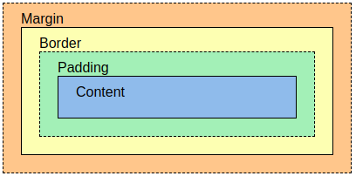
Box Model
The CSS box model is a concept that describes how elements on a webpage are structured and how their dimensions are calculated. It consists of four key components:
It contains – Content, Padding, Border, Margin

Slide 37
Box Model
1. content:
The main area where the text, images, or other content of the element is displayed. The size of this area is defined by the width and height properties.
2. padding:
It specifies the space between border and content of an element
3. border:
A line that surrounds the padding and content. Borders can have different thicknesses, styles, and colors.
4. margin:
It specifies the space around the element. Helps to change position of element
margin is a shorthand property of margin-top , margin-bottom , margin-left , margin-right
Margin : 10px (T) 20px (R) 30px (B) 40px (L)
Margin : 10px (T) 20px (L/R) 30px (B)
Margin : 10px (T/B) 20px (L/R)
Margin : 10px (T/B/L/R)
Same as for padding also, but we cant not pass negative values in padding but we can pass in margin

Slide 38
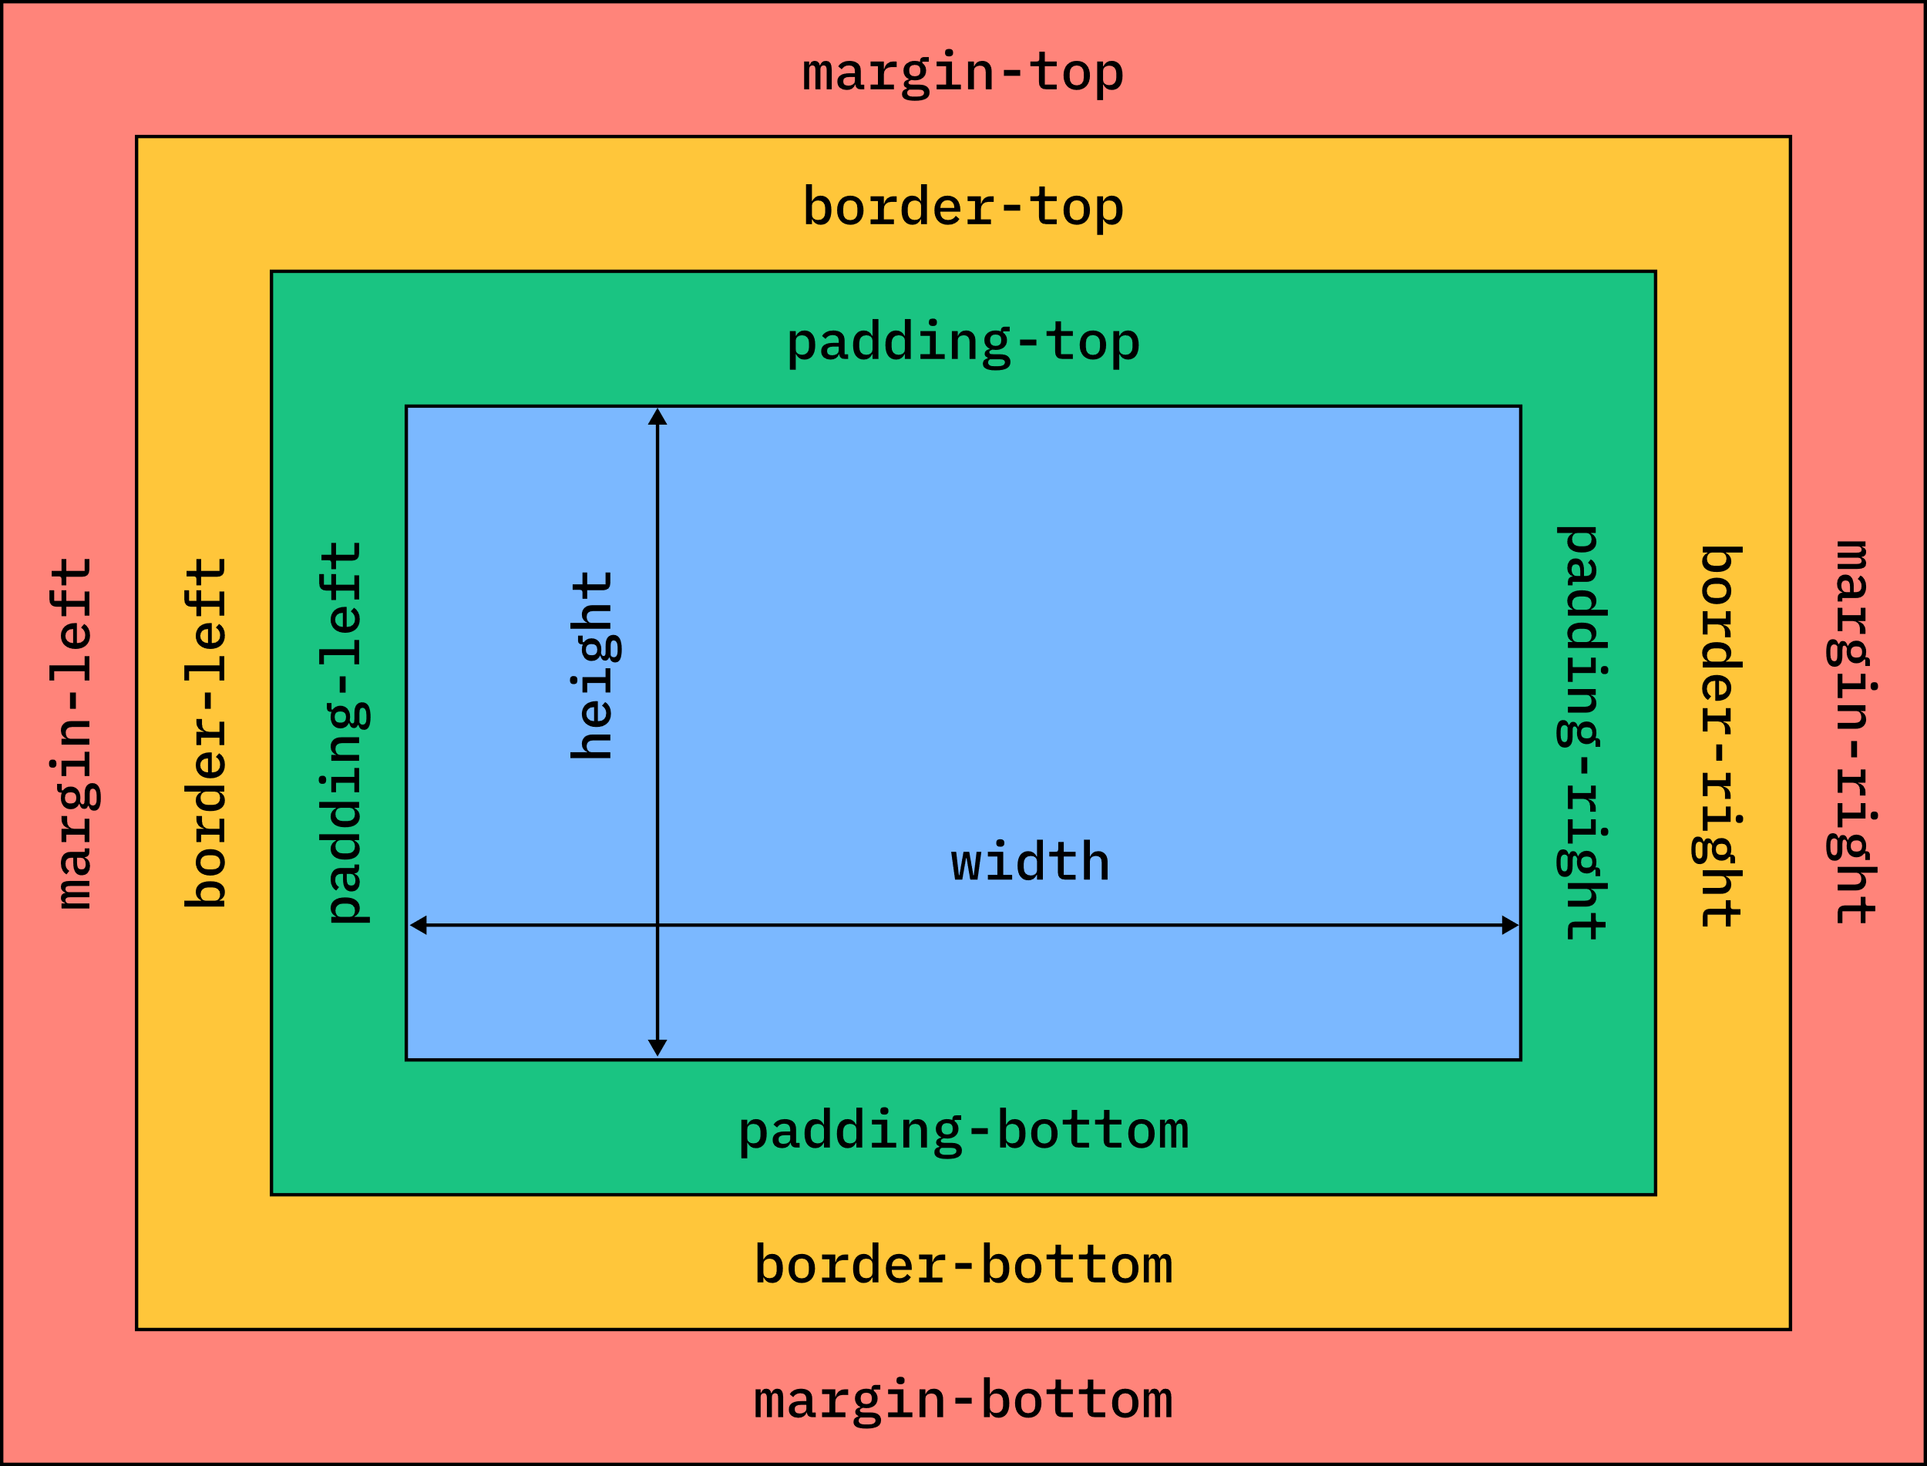
Box Model
Height Calcualtion:
Total height of element = margin-top + border-top + padding-top + content-height + padding-bottom + border-bottom + margin-bottom
Width Calculation:
Total width of element = margin-left + border-left + padding-left + content-width + padding-right + border-right + margin-right

Slide 39
Box Model
Box-Sizing:
It will specify the size of an element. It will accept values like cotent-box, border-box
The default value is content-box
Border-box will fix the height and width, so padding will not affect the size of an element
Note - To remove the default margin and padding of each element we have to use
margin:0; padding:0;
So we have to use
*{
margin: 0;
padding: 0;
box-sizing: border-box;
}

Slide 40
Positions
Positions
Positions are used to arrange the elements in a web page. It will change the position based on position behavior.
They are:
1.Static
2. Relative
3. Absolute
4. Fixed
5. Sticky
To deal with positions we have to use helping properties.
They are:
1. top
2. bottom
3. Left
4.right

Slide 41
Positions
1. Static:
a. It is the default value.
b. It will not perform any changes to the element.
c. Helping properties was not required.
2. Relative:
a. It will change the position of an element with respect to the original position.
b. It will leave an empty space. It doesn’t allow other elements to occupy its place.
3. Absolute:
It will change the position of an element with respect to the parent.
b. By default the parent is a viewport, if we need to change we have to pass position:relative for parent element.
c. It will not leave any empty space. It allows other elements to occupy its place.
d. If we provide position:absolute for all the elements , all elements will float on each other.
e. To specify which element has to float top or bottom , we have to use the z-index property..

Slide 42
Positions
4. Fixed:
a. It will fix the position of an element.
b. To fix the position we have to mention the helping properties.
5. Sticky:
A .Initially these elements will scroll until it reaches to some point.
b. Then it will stick at that position.
Note: If we specify the position as relative / absolute / fixed / sticky elements will float on the z-axis. All of the above need the help properties. We should not use top and bottom / left and right at a time.

Slide 43
Z-Index
Z-index
The z-index property specifies the stack order of an element.
An element with greater stack order is always in front of an element with a lower stack order.
Note: z-index only works on positioned elements (position: absolute, position: relative, position: fixed, or position: sticky)

Slide 44
What is !important?
The !important rule in CSS is used to add more importance to a property/value than normal.
#myid { background-color: blue; } .myclass { background-color: gray; } p { background-color: red !important; }

Slide 45
Display property
Display
Display property allows to change the behavior of an element.
It accepts the values like
● None
● Inline
● Block
● Inline-block
● Flex

Slide 46
Display property
None:
● This will not display anything in the browser.
● As well as it will not occupy any space for the element.
Inline:
● It will convert the element into inline-level.
● So then the element will occupy only content height and width.
● We cannot assign height & width properties.
Inline-Block:
● It will convert the elements into inline-block level.
● So then it will have features of both inline & block level.
● Because of inline → It will display in the same line.
● Because of block → we can assign height & width properties.

Slide 47
Display property
Flex:
● It will layouts the webpages in one dimensional format.

Slide 48

FLEX
Flex:
It will layouts the webpages in one dimensional format.
To work with flex boxes, We need a flex container and all the direct children will become the flex-items. (ONLY DIRECT CHILDREN).

Slide 49
FLEX
Flex Container Properties:
1. Display : flex
2. justify-content
3. align-items
4. flex-direction
5. flex-wrap
6. column-gap
7. row-gap
8. gap

Slide 50
FLEX
1. display: flex;
This is the main property we must use to work with flex boxes. By assigning this property we are able to use all flex properties.
2. Justify-content
It will align the flex-items on the main axis.
Syntax:
justify-content: values;
Values = start , center , end , space-between , space-evenly , space-around.
The default value is start.

Slide 51
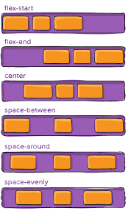
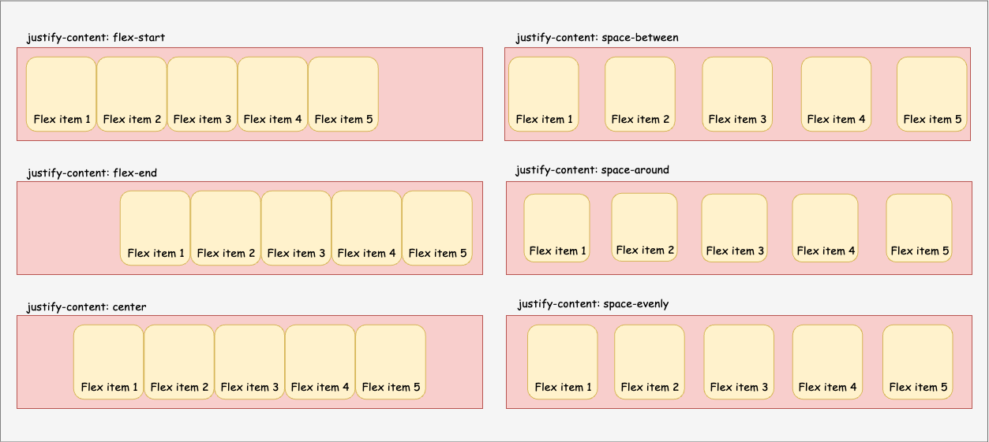
FLEX
2. justify-content: values;

Slide 52
FLEX
3. align-Items: It will align the flex-items on the cross axis.
Syntax:
align-items: values;
Values = start , center , end , stretch ,
baseline.
The default value is start.

Slide 53
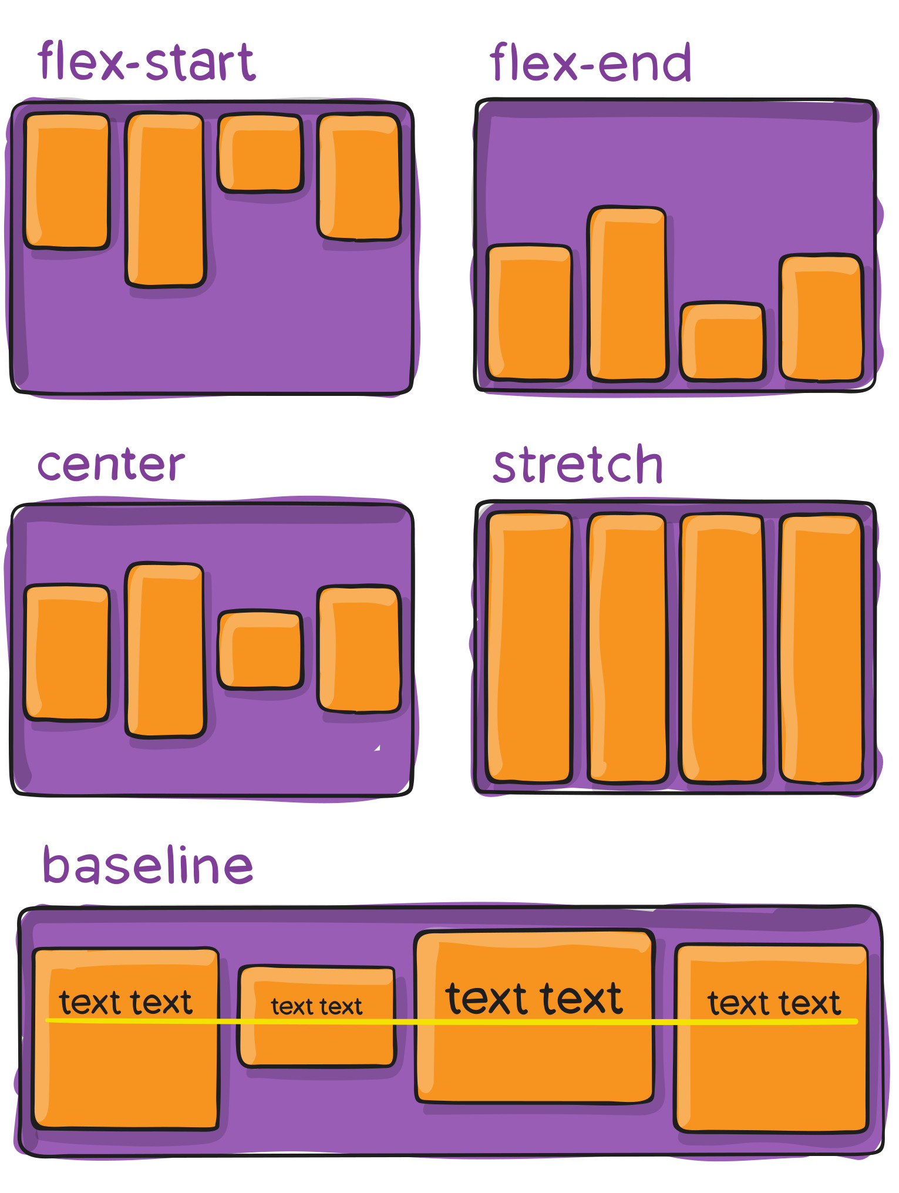
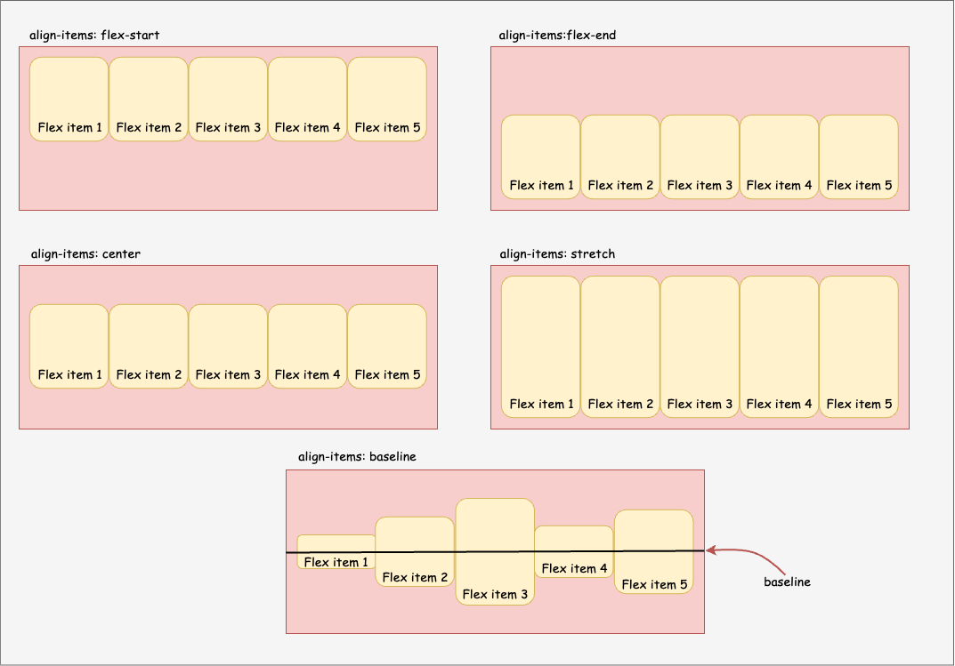
FLEX
3. align-items: values;

Slide 54
FLEX
4. flex-direction: It will specify the direction of flex-items. Whether to display in row format or column format. It will decide the main axis.
Syntax:
flex-direction: values;
Values = row , column , row-reverse ,
column-reverse.
The default value is row.

Slide 55
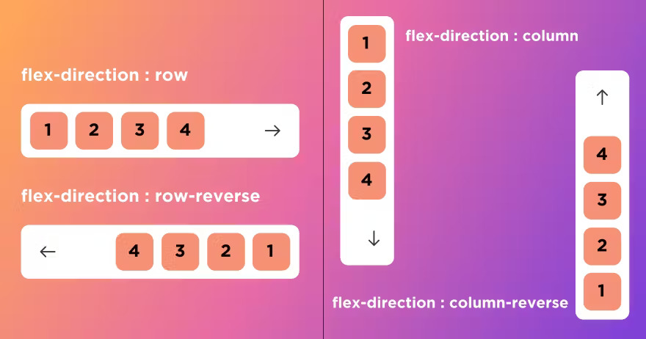
FLEX
4. flex-direction: values;

Slide 56
FLEX
5. flex-wrap: It will specify whether to wrap the flex-items into the next line or not.
Syntax:
flex-wrap: values;
Values = nowrap , wrap , wrap-reverse.
The default value is nowrap.

Slide 57
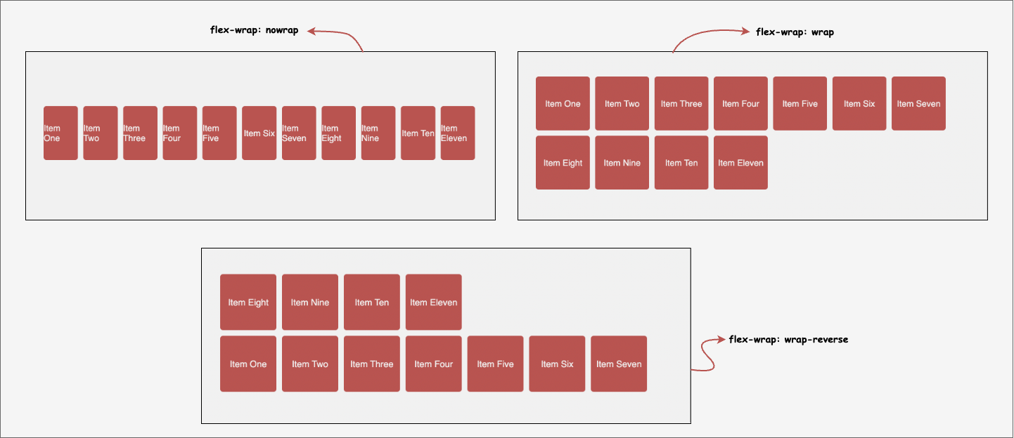
FLEX
5. flex-wrap: values;

Slide 58
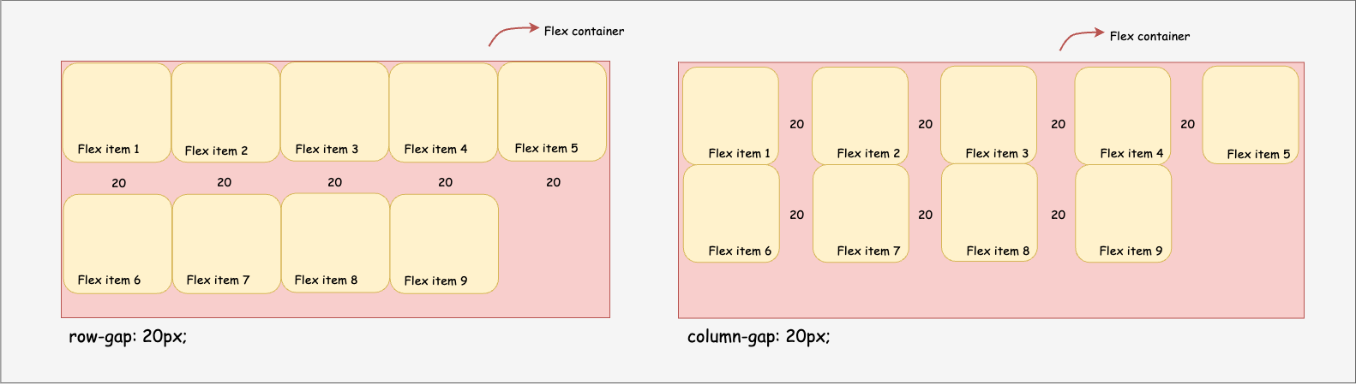
FLEX
6. gap:
It is a shorthand property of row-gap & column-gap. It will specify the space between the flex items.
Ex: row-gap:20px & column-gap:20px;

Slide 59
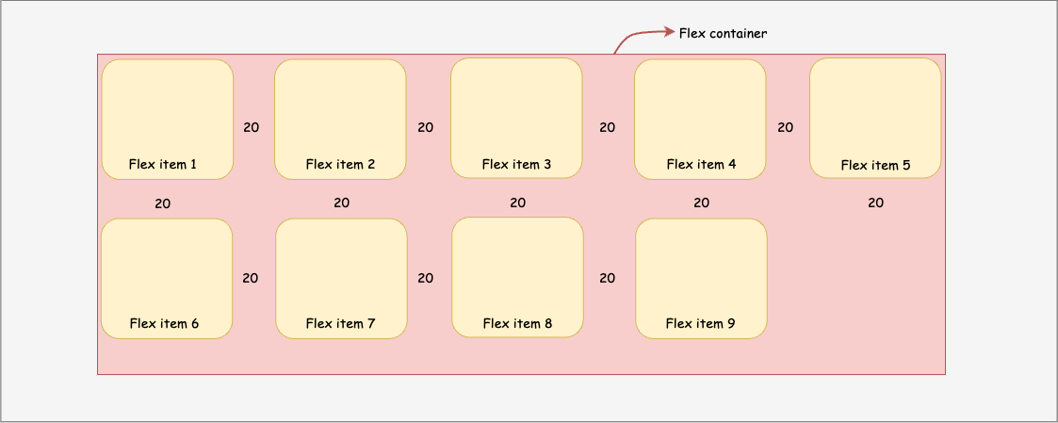
FLEX
gap : 20px;

Slide 60
FLEX
Flex items Properties:
1. order
2. align-self
3. flex-grow
4. flex-basis
5. flex-shrink
6. flex

Slide 61
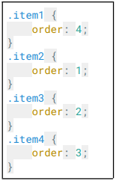
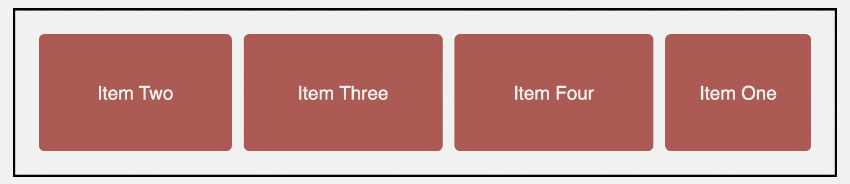
FLEX
1. Order : It will arrange the flex-items in an order.
Ex:

Slide 62
FLEX
2. align-self:
By using this property, we can align the flex-items individually.
It will override the default alignment which is specified by align-items.
It will accept all the values which can be acceptable by align-items property.
The only difference is
i. align-items for container for all flex-items.
ii. align-self for items for individual flex-item.

Slide 63
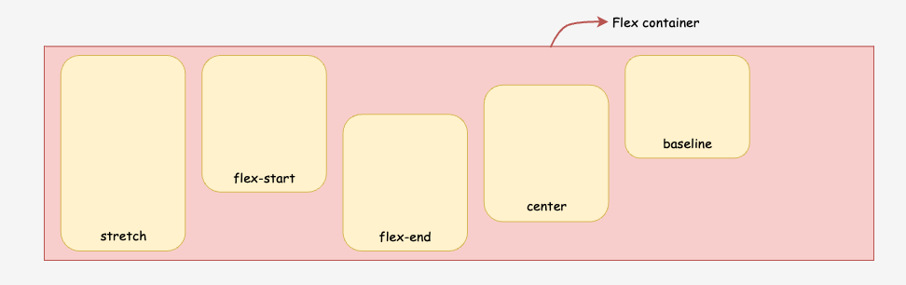
FLEX
2. align-self: value;
Values :

Slide 64
FLEX
3. Flex-grow:
It will make sure the flex-items have to fit to the flex-container.
It will increase the size of the flex–items based on remaining space.
The remaining space in a container will be divided into units and it will be added to each flex-item based on flex-grow values

Slide 65
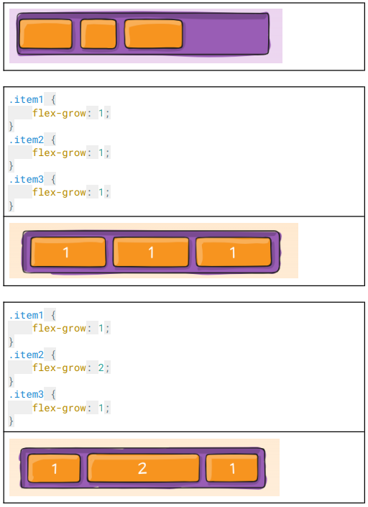
FLEX
3. Flex-grow:

Slide 66
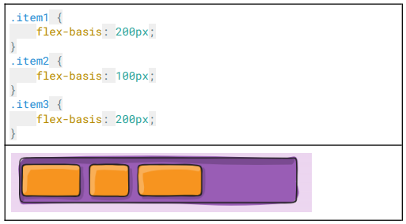
FLEX
4. flex-basis It is equivalent to the width property.
This overrides any previously defined width for that element.
Ex:

Slide 67
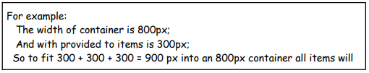
FLEX
5. flex-shrink: It will shrink the size of the flex-items. Based on the extra space required in a container to fit all the flex-items.
If there is no enough space in a container to fit all the flex-items then all flex-items will shrink(decreases) equally and fit’s in a container.

Slide 68
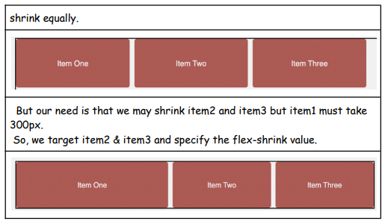
FLEX
5. flex-shrink

Slide 69
FLEX
6. Flex
It is a shorthand property of flex-grow , flex-shrink and flex-basis.
Ex: flex: 1
flex : flex-grow flex-shrink flex-basis;
flex : 1 1 400px;
If we specify flex 1 , it will increase , decrease , and width equally.

Slide 70

Thank you

